Slide 1
I/O & file handling

Slide 2
Objectives of This Session
Identify Streams
Describe the I/O hierarchy
Explain the File, RandomAccessFile classes
Identify the Reader & Writer classes

Slide 3
Program
destination
source
Input Stream
Output stream
File
Input device
socket
File
Output device
socket

Slide 4

Streams
InputStream – This depicts the flow of bytes from data source to the programs memory.
OutputStream – This depicts the flow of bytes from the programs memory to the destination data store.
Java views these streams in terms of objects that will perform different operations on the streams through their method calls.
Two basic operations involved are
  Read from input stream
  Write to output stream

Slide 5
java.io package
Provides an extensive set of classes for handling I/O to & from various devices.
Contains many classes each with a variety of member variables & methods.
It is layered i.e.. it does not attempt to put too much capability into a single class.
Instead a programmer can get the features he wants by layering one class over another.

Slide 6
Object
FileDescriptor
File
OutputStream
InputStream
DataInput
RandomAccessFile
DataOutput
SequenceInputStream
StringBufferInputStream
ByteArrayInputStream
PipedInputStream
FileInputStream
FilterInputStream
ByteArrayOutputStream
PipedOutputStream
FileOutputStream
FilterOutputStream
LineNumberInputStream
BufferedInputStream
DataInputStream
PushbackInputStream
PrintStream
BufferedOutputStream
DataOutputStream

Slide 7


IO hierarchies
Two Major hierarchies in Java
  InputStream and OutputStream class hierarchy
    This hierarchy enables data input output in binary mode.
  Reader and Writer hierarchy
    This hierarchy enables data input output in text mode.

Slide 8
InputStream class
An abstract class that defines methods for performing I/p.(Read from source)
Serves as base class for all other InputStream classes.
Defines a basic interface for reading streamed bytes of information.
Data in InputStream is transmitted one byte at a time.

Slide 9
Some methods of the InputStream class
int read()
int read(byte b[])
int read(byte [] b, int offset, int len)
int available()
long skip(long n)
synchronized void mark(int readlimit)
boolean markSupported()
synchronized void reset()
void close()

Slide 10
Technique for using Java IO package
Step1- Choose a suitable input or output stream class
Step2- Create the object of the chosen class.
Step3- While creating the object associate it with the source or destination in the constructor ( depending on whether it is Input or output object)
Step4- Once the object is obtained invoke a suitable read or write method using the object.

Slide 11

FileInputStream class
Obtains input bytes from a file in a file system. Useful for performing simple file I/O.
Can be instantiated using one of the following three constructors:
  FileInputStream(String name)
  FileInputStream(File file)
  FileInputStream(FileDescriptor fdObj)

Slide 12
FilterInputStream
This is a base class for other classes that act like a filter to transform the raw data bytes to a desired form.
The important subclasses are
  DataInputStream
  BufferedInputStream
  SequenceInputStream

Slide 13
Chaining or layering of streams
To use these file filters chaining of streams is required.
FileInputStream fis = new
FileInputStream(“c:\a.txt”);
DataInputStream bis = new
DataInputStream(fis);

Slide 14
DataInputStream
Useful for reading primitive java data types from an I/P stream in a portable manner.
It aggregates groups of bytes into primitive data types.
Methods implemented by DataInputStream are variations of the read() method for different fundamental data types.

Slide 15
OutputStream
Similar to InputStream there is an OutputStream class
The methods in OutputStream class are
  Write()
  Flush()
The important OutputStream subclasses are
FileOutputStream
PipedOutputStream
FilterOutputStream
- DataOutputStream

Slide 16
File class
Models an OS dir entry, enabling you to access info about a file.
File objects are used to do all operations related to files & directories.
Objects of File do not actually open a file or provide any file processing capabilities.
It provides methods for performing file related operations that actually interact with the underlying file system.

Slide 17
File class methods
boolean canRead() / canWrite()
boolean exists()
boolean isAbsolute()
boolean isDirectory() / isFile()
String getParent()
long length()
String[] list()
boolean mkdir()
boolean delete()
boolean createNewFile()

Slide 18
RandomAccessFile
RandomAccessFile(String name, String mode)
RandomAccessFile(File file, String mode)
This class lets you find or write data anywhere in a file.
A RAF has a file-pointer setting that comes with it.
The FP indicates the position of the next record that will be read or written.

Slide 19
RandomAccessFile
seek(long pos) : sets the file pointer to an arbitrary byte position within the file.
getFilePointer() : returns current location of file pointer from the beginning of file.
long length() : length of file in bytes.
skipBytes() : moves current input position the specified number of byte forward or backward.

Slide 20
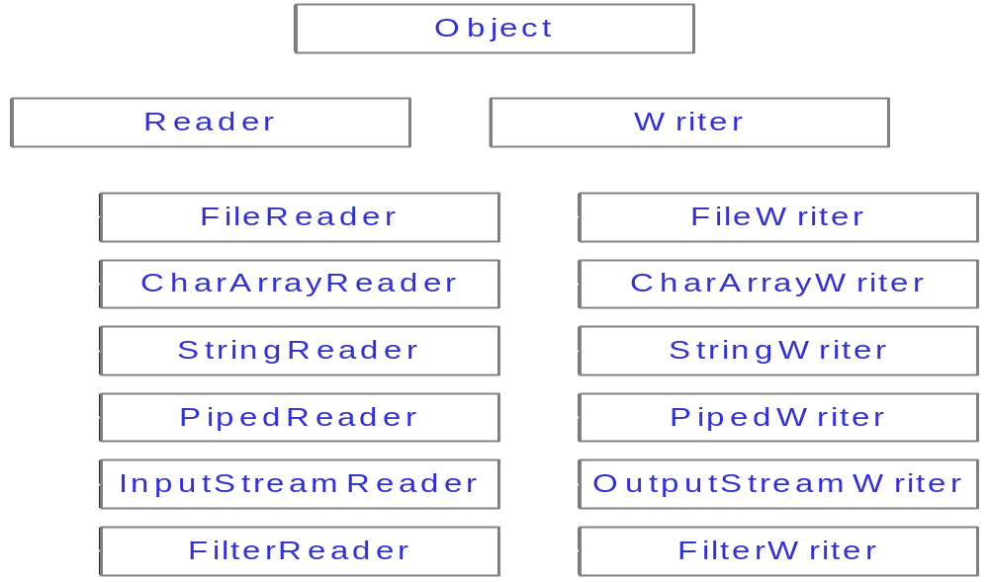
Reader – Writer Hierarchy

Slide 21
Assignment
Write code to copy one file to another through a Java program.
Write code to take input from keyboard about the Name , age and salary of the employee and write it back to a file.

Slide 22
StringBufferInputStream class
Enables user to use a string as a buffered source of input.
This class allows an application to create an input stream in which the bytes read are supplied by the contents of a string
public StringBufferInputStream(String s)
  Creates a string input stream to read data from the specified string

Slide 23
The System class
Three static I/O objects have already been created by the time main() method gains control.
All 3 are public static members of System class.
  System.in
  System.out
  System.err
  Streams associated with these objects provide communication channels between a program & a particular file or device.

Slide 24
import java.io.*;
class ReadKeys {
public static void main (String args[]) {
StringBuffer sb = new StringBuffer();
char c;
try {
while((ch =(char)System.in.read()) != '\n'))
{
sb.append(c); }
}
catch (Exception e) { ... }
String s = new String(sb);
System.out.println(s);
}
}

Slide 25
SequenceInputStream
Used to represent a sequential inputstream.
  i.e. A stream in which the contents of I / P stream is composed of the contents of an ordered list of I/P streams.

Slide 26
BufferedInputStream
By default streams are not buffered.
  I.e. every call to read() contacts the OS to ask it to provide next byte.
BufferedInputStreams reads characters from a stream without causing a device access everytime.
Maintains a buffer of bytes read from the original input stream.

Slide 27
BufferedInputStream
Requests to read from the BufferedInputStream, retrieves bytes from this buffer, rather than performing read() operations on original InputStream.
When all bytes from the buffer have been read, the buffer is refilled with input from the original inputstream.
This can improve performance significantly because it reduces the number of read() operations on the original input stream.

